Slide 1
Market Research on MOOC Sites

Slide 2
Business Case
The objective of this research is to gather intelligence about existing MOOC sites and analyze them, which will help us position our product “Crampete”,which will be rolled out to public in future.
Study different MOOC business models and try to ensemble those in our product for better hits/enrollments.
Perform feature testing or A/B,SWOT and promotion research.

Slide 3
Activities
Primary Data Collection.
Competitor analysis.
Study about website metrics.
Use appropriate visuals to present the findings.
Improvise website by A/B testing.
Perform conjoint analysis.
Test features.

Slide 4
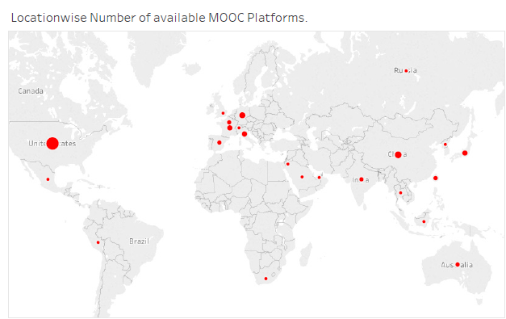
MOOC Popularity across the globe
Using data collected via primary research, visualization is done using Tableau.
Market size of MOOC is large in the United States compared to all other locations.

Slide 5
Age Group
During primary research, age groups showed variation in enrollments.
People within age group 18- 34 showed most enrollments.
People belonging to age group 55-65+ showed least enrollments in all the 22 MOOC portals analyzed.

Slide 6
Slide Title
Our research is completely focused on studying the existing MOOC portals.
22 popular MOOC sites are analyzed till date.
A primary research or data gathering is done to capture basic information about each site in the form of business model canvas.
Data is collected from different websites like Similarweb, crunchbase & Alexa rating.
Using the data collected during primary research, secondary research is done and appropriate visuals are used for infographics.

Slide 7
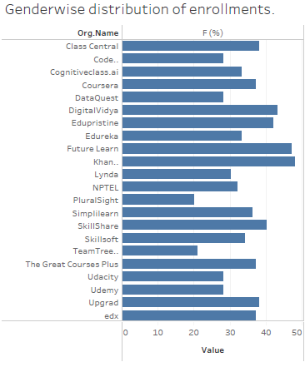
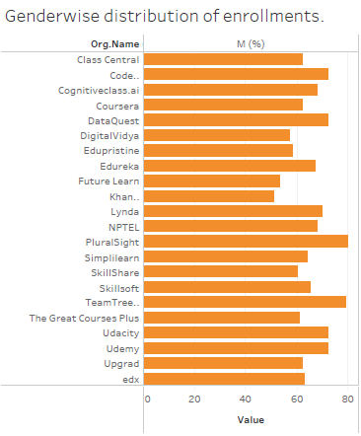
Genderwise Enrollments for every MOOC portal under study
Gender Distribution Female
Gender Distribution Male

Slide 8
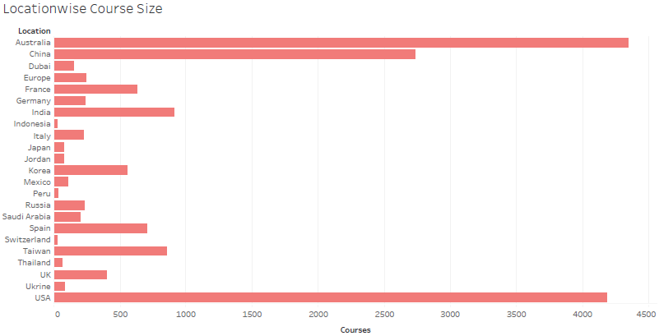
Locationwise MOOC courses count.
Plot shows USA & Australia has highest courses.

Slide 9
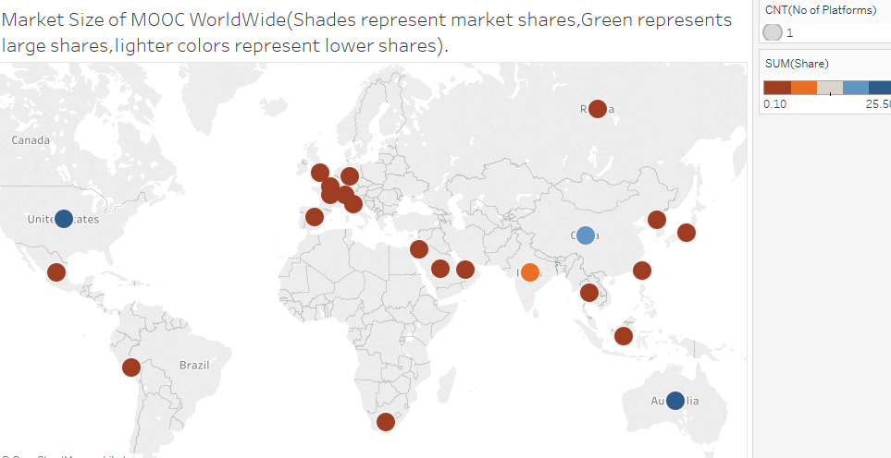
Market Size of MOOC in different locations
Plot shows China, Australia & United States have good market size.

Slide 10
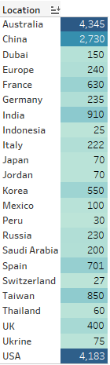
Course origin worldwide
Data is obtained from primary research.
Visualization is done using Tableau.
Heat map view shows Australia and US having highest number of courses.

Slide 11
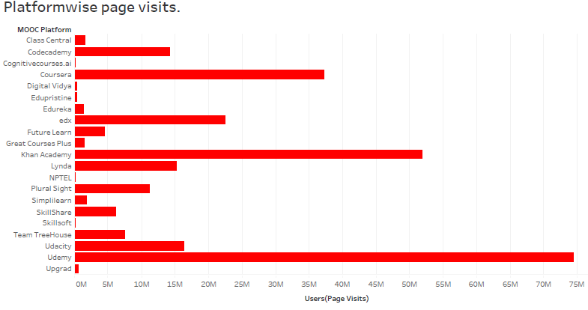
Number of hits for each platform
Plot shows that Udemy and Khan academy tops number of hits.

Slide 12
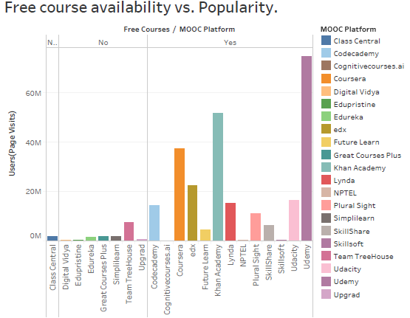
Popularity and Free Courses
Class Central being an aggregator site is not considered here for analysis.
Codecademy,Course-ra and edx having free courses, i.e., you have to pay to get certifications has more popularity compared to other sites where you have to pay for enrolling into a course.

Slide 13
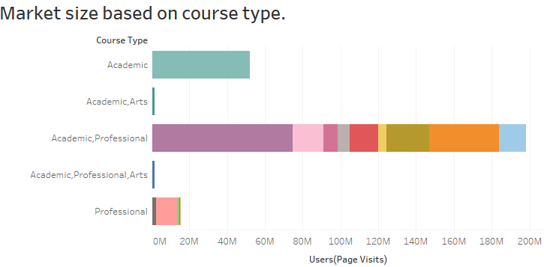
Market Size
Visual shows how each category or type of MOOC have market size.
Category Academic & Professional – means that the site has courses for both hard and soft skills for professionals, as well as students.
There are some sites that host courses related to fine arts including but not limited to Photography, Literature,Music.
Those have size less than a million USD.

Slide 14
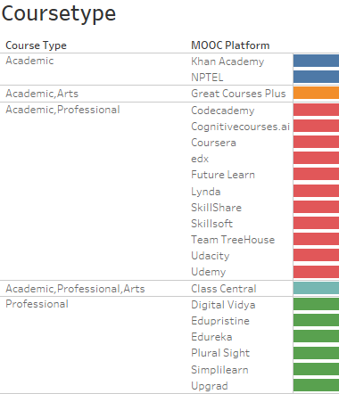
Who offers which course?
Adjacent visual shows which MOOC site offers which type of course.
Khan academy has courses related to academics.
Other courseware's are for soft and hard skills.
Class Central is an aggregator site.

Slide 15
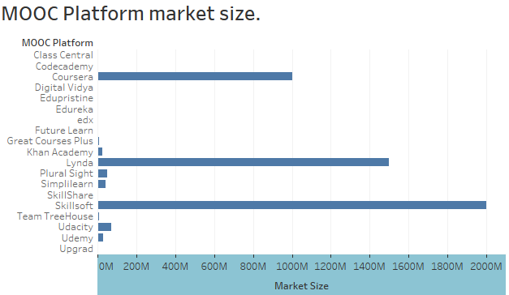
Size of MOOC Market
Lynda & Coursera tops the list.
Udacity, Udemy,Pluralsight and simplilearn comes next.
All others are >100 million USD.

Slide 16
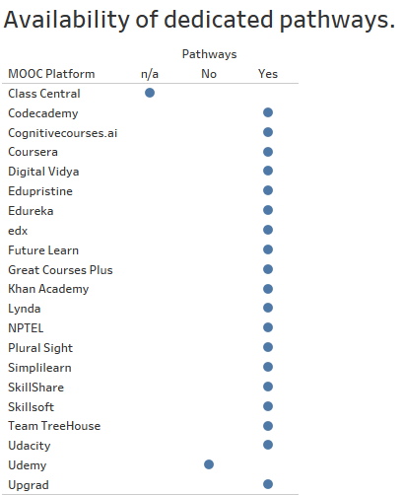
Pathways?
Availability of pathways for each hard skill.
For example, having a data science pathway will guarantee that the user upon completion will have a full stack knowledge about data science viz-a-viz, statistics, data analysis, data mungging, visualisation and so on.

Slide 17
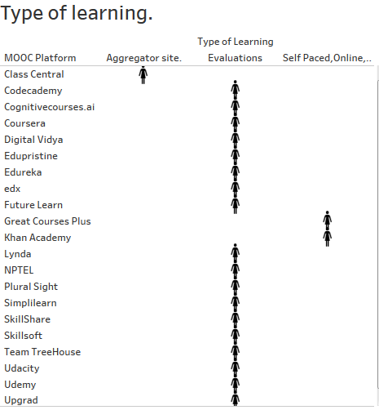
Type of learning
Great courses plus and Khan academy does not have focused evaluation schemes to rank you or give certifications.
All others have evaluations and every course is self paced.

Slide 18
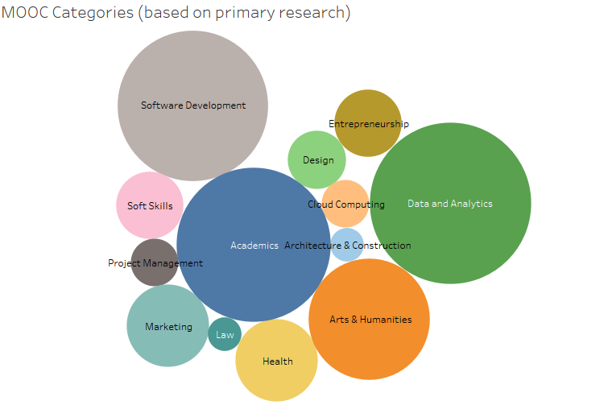
Which courses are popular?

Slide 19
Coursera – Features
Courses in coursera are offered by professors of reputed universities worldwide.
Courses are split to Courses, Specialisation, Certificate, Degree & Master Track. Each with appropriate pricing.

Slide 20
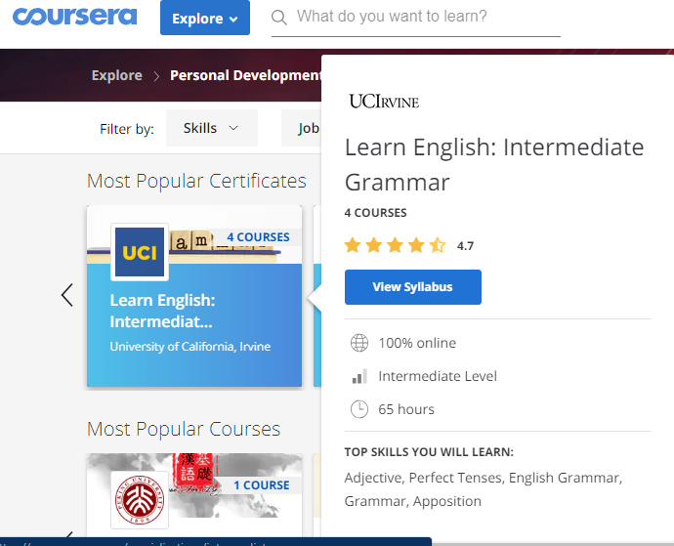
Features - Coursera
Quick summary of the course with data like,
Duration of the course.
Level
Skills the user can learn.

Slide 21
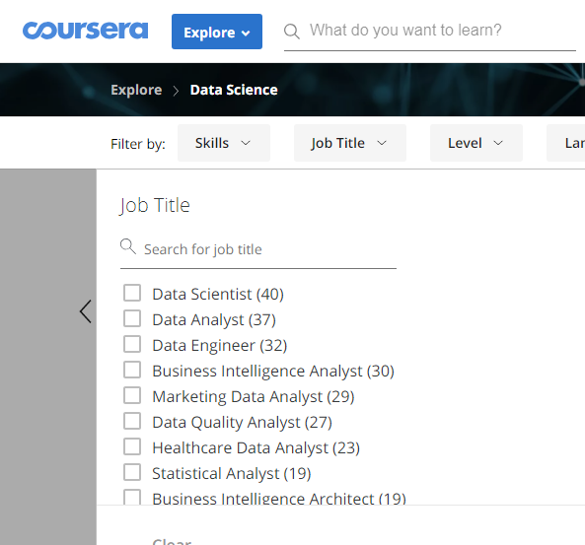
Job Title
Coursera has a filtering option which lets you choose courses based on users job role.

Slide 22
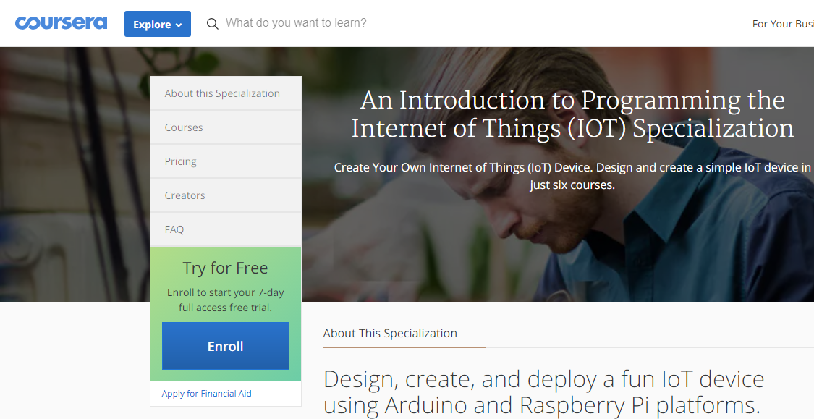
Course fee and trial options
Some of the courses in coursera are free of cost.
When user enrolls in a course tagged specialisation or degree course fee has to be paid.
A free trial period of 7 days is permitted after which course fee has to be paid.
Apply for financial aid – lets student to apply for a financial aid which will be processed within 15 days of submission.

Slide 23
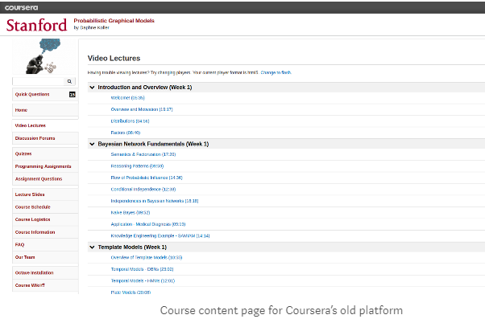
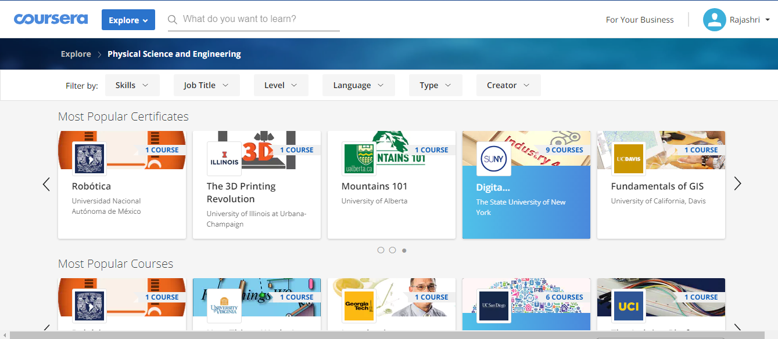
Old vs New

Slide 24
Plural Sight - Features

